Slide 1
VEHICLE PLATE RECOGNITION USING MATLAB
Presented by
NAME

Slide 2
CONTENTS
Objectives
Abstract
Introduction
Literature Review
Problem Identification
Existing System
Proposed System
Hardware/ Software Requirements
Results and Discussion
Conclusion
References
Certificate

Slide 3
OBJECTIVES
To develop a well-organised system in the vehicle number plate detection.
The major techniques used in the implementation of the designs are gray scale conversion, black and white image conversion, filling holes, border detection and image segmentation.
This is helpful to easily detect the license plate and identify the vehicle details. This is implemented on the real images.

Slide 4
ABSTRACT
Vehicle plate recognition (VPR) is the extraction of vehicle license plate information from an image. The system model uses already captured images for this recognition process
First the recognition system starts with character identification based on number plate extraction, Splitting characters and template matching
VPR as a real life application has to quickly and successfully process license plates under different environmental conditions, such as day time
It plays an important role in numerous real-life applications, such as automatic toll collection, traffic law enforcement, parking lot access control and road traffic monitoring
The system uses different templates for identifying the characters from input image. After character recognition, an identified group of characters will be compared with database number plates for authentication

Slide 5
CONTD.,
The proposed model has low complexity and less time consuming in terms of number plate segmentation and character recognition
This can improve the system performance and make the system more efficient by taking relevant sample.
At the same time compared their advantages and disadvantages, which provide the basis for vehicle plate recognition

Slide 6
INTRODUCTION
In recent decades, intelligent facility has been developed as a serious tool which has several novel quick strategies that ITSs become additional that increasing of the amount of vehicles required to be controlled by the mistreatment of vehicle plates (for example, the vehicle identification in toll booths, parking decks, border management and enforcement)
The vehicle license plates of the automobiles serve as identification to the automobiles that distinguish from alternative vehicles. Several algorithms are developed in image processing technology to acknowledge vehicle plates
A camera captures the vehicle pictures and therefore the PC processes the captured pictures, detects the registration number plate from the input pictures so reads data from registration .number plate by applying varied image process and optical character.

Slide 7
LITERATURE REVIEW
S.No | Title | Author & Year | Journal/Reference Name | Remarks
1. | Vehicle Number Plate Recognition System | Aniruddh Prance & Umadevi V. (2016) | International Journal of computer applications. | The accuracy of license plate recognition systems can be affected by various factors such as lighting conditions, weather conditions, and the quality of the images captured. This can lead to incorrect readings and false positives or negatives.
2. | Matlab Based Vehicle Number Plate Recognition | Shilpi Chauhan & Vishal Srivastava(2017) | International Journal of Computational Intelligence Research | License plate recognition systems can be expensive to install, maintain, and operate. This can limit the implementation of the technology in certain areas or by certain organizations.

Slide 8
CONTD.,
S.No | Title | Author & Year | Journal/Reference Name | Remarks
3. | License Plate Character Recognition system using KNN | Yen-Ching Chang (2006) | International Conference on Computing Methodologies and Communication | The use of license plate recognition systems may raise legal issues such as data protection, privacy, and the use of the technology for law enforcement purposes.
4. | Automatic Detection of Vehicle License Plate and Character Recognition | Pawan Wawage, Shraddha Oza (2013) | International Journal of Emerging Technology and Advanced Engineering | License plate recognition using MATLAB may require significant processing time, especially when processing high-resolution images or video streams. This can result in slower performance and a delay in the identification process.

Slide 9
PROBLEM IDENTIFICATION
Researchers have to face various problems while automatic detection and recognition of vehicle plate. To explored few major problems.
The first problem is the non uniformity of the license number plate models for different cities. It may also varies from one state to another and thus from vehicle to vehicle. Length of the number plates may also vary.
Second prime difficulty is the low resolution of the number plates for vehicles in video frames under typical surveillance systems. The expected solutions for these problems are to develop the sequential coordination of image and video processing tasks.
This processing sequence may include, algorithms Via. object tracking and segmentation, locating the license plate area, detecting number and its color

Slide 10
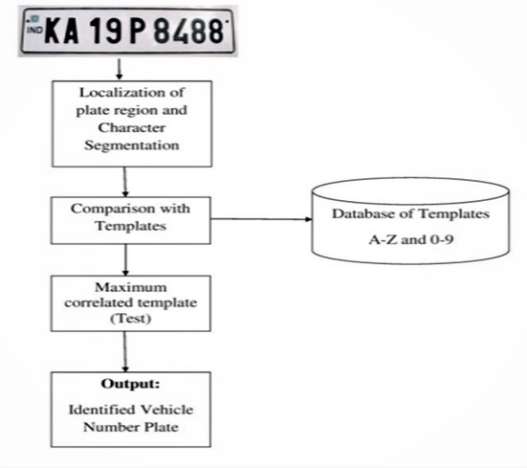
EXISTING SYSTEM

Slide 11
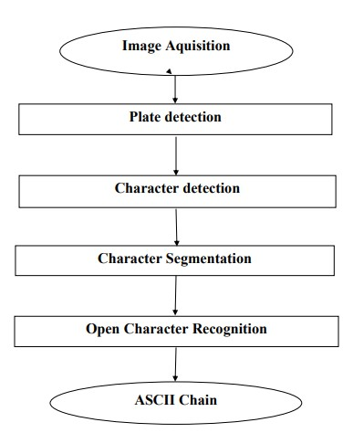
PROPOSED SYSTEM

Slide 12
HARDWARE/SOFTWARE REQUIREMENTS
SOFTWARE REQUIREMENTS:
Operating system : Windows XP WINDOWS 10
Language : MATLAB
11

Slide 13
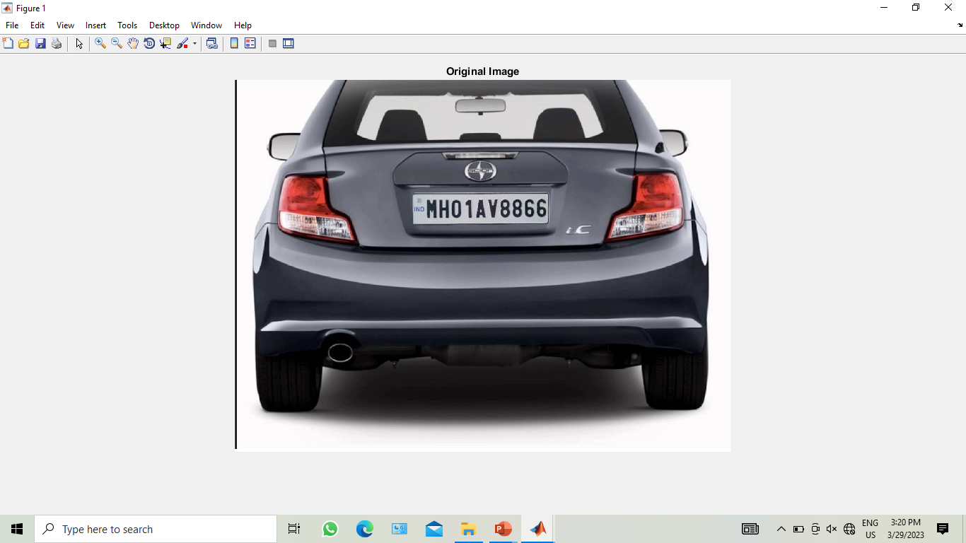

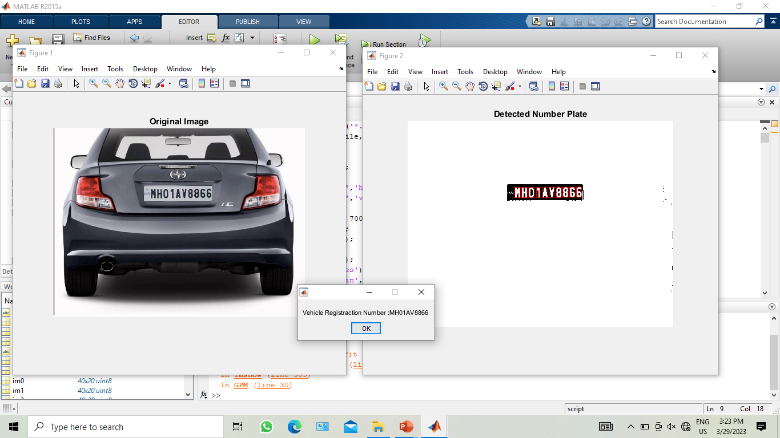
RESULTS AND DISCUSSION
11

Slide 14
CONCLUSION
The image segmentation problem in license plate recognition for Indian vehicle Plates has been examined in two stages: license plate Localization and extraction from the scene followed by the separation of the characters from the previously extracted license plate region background.
Various approaches for license plate detection in an image, and extensive experiments have been devised to test them are presented. The purpose of this thesis has been to investigate the scope of automatic vehicle plate recognition under minimal restrictions.
The main objective is aimed at contributing towards the research in the fields of machine vision, pattern analysis and image processing.
A better performing class of segmentation algorithms in comparison with the available algorithms in the field is developed. Experimental results showed that the proposed technique gives 96.69 % accurate results for character regions recognition.
11

Slide 15
REFERENCES
M.A. Sotelo , J. Nuevo , L.M. Bergasa and M. Ocana,(2005) “Road Vehicle Recognition in Monocular Images,” IEEE Symposium on Industrial Electronics.
Anton Satria Prabuwono and Ariff Idris, (2008) "A Study of Car Park Control System Using Optical Character Recognition," International Conference on Computer and Electrical Engineering.
Saeid Rahati, Reihaneh Morvejian, Ehsan M. Kazemi and Farhad M. Kazem,(2008)“Vehicle Recognition Using Contourlet Transform and SVM,” Proceedings of the Fifth International Conference on Information Technology.
SaimaRafique, Mahboob Iqbal and Hafiz Adnan Habib,(2009) “Space Invariant Vehicle Recognition for Toll Plaza Monitoring and Auditing System”, Multitopic Conference,. INMIC 2009,IEEE 13th International.
Weihua Wang,(2009) "Reach on Sobel Operator for Vehicle Recognition, "International Joint Conference on Artificial Intelligence.
Jianbin Jiao, Qixiang Ye, and Qingming Huang,(2009) "A configurable method for multi-style license plate recognition," Pattern Recognition, volume-42.
Yang Yang, Xuhui Gao, and Guowei Yang,(2011) "Study the Method of Vehicle License Locating Based on Color Segmentation," Procedia Engineering, volume-15.

Slide 16
CONTD..
Ying Wen,(2011) "An Algorithm for License Plate recognition Applied to Intelligent Transportation System", IEEE Transactions of Intelligent Transportation Systems.
Ch. Jaya Lakshmi, Dr. A. Jhansi Rani, Dr. K. Sri Ramakrishna, and M. Kanti Kiran, (2011) "A Novel Approach for Indian License Recognition System," International Journal of Advanced Engineering Sciences and Technologies, volume-6.
H. Erdinc Kocer and K. Kursat Cevik,(2011) "Artificial neural networks based vehicle license plate recognition," Procedia Computer Science, volume-3.
A Roy and D.P Ghoshal, (2011) "Number Plate Recognition for use in different countries using an improved segmentation," National Conference on Emerging Trends and Applications in Computer Science.
Zhigang Zhang and Cong Wang, (2012)"The Research of Vehicle Plate Recognition Technical Based on BP Neural Network," AASRI Procedia, volime-1.
Fikriye Öztürk and Figens Özen, (2012) "A New License Plate Recognition System Based on Probabilistic NeuralNetworks," Procedia Technology, volume-1.

Slide 17
THANK YOU

